Slide 1
An Intelligent Public Transport Delay Prediction and Route Optimization System Using Machine Learning
Department of Computer Science and Engineering
Project Work Phase – 1 (CSE 784)
Review - 0
Student Name – Jerin Philip Mathew, Pregin Athish E
Register No - 2360385, 2360439
Section – 7BTCS C, 7BTCS A
Guide Name – Dr. Jyothi Thomas, Dr. Karthikeyan H

Slide 2
Table of Contents
Domain
  Sub -Domain
  Application
Problem Statement & Motivation
Objectives
Methodology
Expected Outcomes

Slide 3
Domain
Domain : Artificial Intelligence & Data Science
Sub-Domain : Machine Learning & Predictive Analytics
Machine Learning and Predictive Analytics methodologies are applied to design a dual engine prediction pipeline that forecasts public transport delay risks and durations.
Applications:
Urban Traffic Management
Peak-Hour Demand Analysis
Public Transit Decision Support Systems
Intelligent Route Optimization
Logistics & Transportation Planning

Slide 4
Problem Statement & Motivation
Problem Identification:
Urban transit systems are essential to smart cities, yet congestion, unpredictable weather, and fluctuating demand cause cascading delays that reduce service reliability and passenger trust. Existing solutions rely on black-box models, struggle with noisy GPS data, and rarely provide actionable rerouting or operational insights.
Motivation:
An Intelligent transport management system is required in this busy era for improving service reliability, supporting data driven operational decisions, and reducing travel delays. By optimizing public transport efficiency, this minimizes passengers travel time, enhances passenger satisfaction, improves quality of life, and increases overall productivity.
Solution:
This project proposes an Intelligent Public Transport Delay Prediction and Route Optimization System that combines a dual-engine machine learning pipeline, Explainable AI for delay analysis, a Schedule-Aware Sequential Delay Propagation framework, and an Explainable Multi-Criteria Shortest Path Routing Algorithm engine, delivered through an interactive dashboard for both commuters and transit planners.

Slide 5
Objectives
To develop a Machine Learning model that accurately predicts public transport delays by analyzing historical transit, traffic, weather, and holiday data for top cities (eg. Chicago, New York).
To optimize travel routes by recommending efficient alternative paths based on predicted delays and provide explainable AI.
To design an interactive dashboard that visualizes delay predictions, route performance, and delay hotspots, providing actionable insights for transport authorities.

Slide 6
Objectives In-Detail
To develop a Machine Learning model that accurately predicts public transport delays by analyzing historical transit, traffic, weather, and holiday data for top cities (eg. Chicago, New York)
Multimodal Data Integration: Collect and integrate schedule data, weather information, and traffic congestion data into a unified dataset.
Data Preprocessing: Organize the data with scheduled stop timings, compute delay values, and handle missing data using various techniques.
Sequential Feature Engineering: To extract sequential delay features that capture how delays propagate between consecutive stops.
Predictive Model Development: Train and optimize an suitable Machine Learning model to identify delay risk and to estimate the expected delay duration.
2. To optimize travel routes by recommending efficient alternative paths based on predicted delays and provide explainable AI.
Transit Network Modelling: Model the road and transit network as a directed weighted graph using different map libraries.
Dynamic Cost Modelling: Design a dynamic edge weight function that incorporates travel time, predicted delays, and safety factors to reflect real-time traffic conditions.
Intelligent Route Optimization: Implement an Explainable Multi-Criteria shortest path Routing algorithm to identify optimal routes and recommend alternative paths when delays are predicted.
Explainable AI Integration: Integrate SHAP to explain model predictions and generate user friendly explanations for route recommendations and predicted delays.

Slide 7
3. To design an interactive dashboard that visualizes delay predictions, route performance, and delay hotspots, providing actionable insights for transport authorities.
Transit Monitoring Dashboard: Design a dashboard to monitor transit performance and visualize congestion hotspots using DBSCAN clustering and interactive heatmaps.
Decision Support Recommendations: Implement a recommendation system to suggest schedule adjustments and operational actions, such as buffer time allocation or backup vehicle deployment, based on recurring delay patterns.

Slide 8
Methodology

Slide 9
Expected Outcomes
Outcome 1: Predictive Delay Analytics Engine
A. Binary Delay Classifier (Classification Model): The system classifies scheduled transit runs as either 'Delayed' or 'On-Time' based on a threshold. This gives commuters a straightforward risk score.
B. Delay Duration Regressor: For trips predicted as delayed, a regression model outputs the expected delay in minutes. This provides the mathematical basis for route weighting and dynamic pathfinding.
Outcome 2: Explainable Dynamic Routing
Multi-Criteria Shortest Path Algorithm Detours: Recalculates the optimal path. If a passenger's standard route contains high delay risks, the routing engine identifies alternative paths that bypass delayed segments.
SHAP Natural-Language Explanations: Runs local SHAP calculations on the delayed segments and prints an explanation card

Slide 10
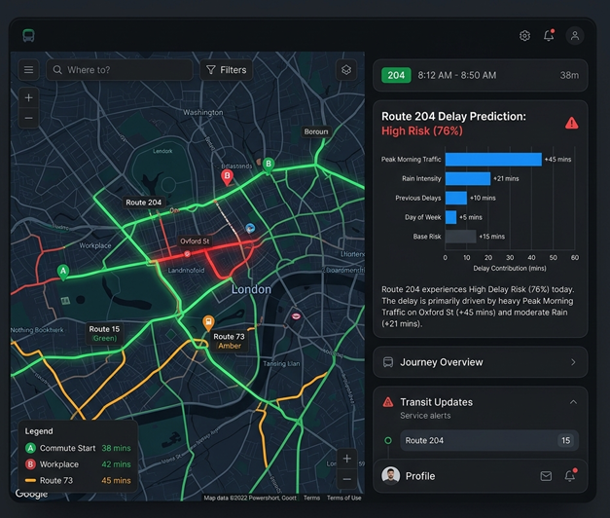

Slide 11
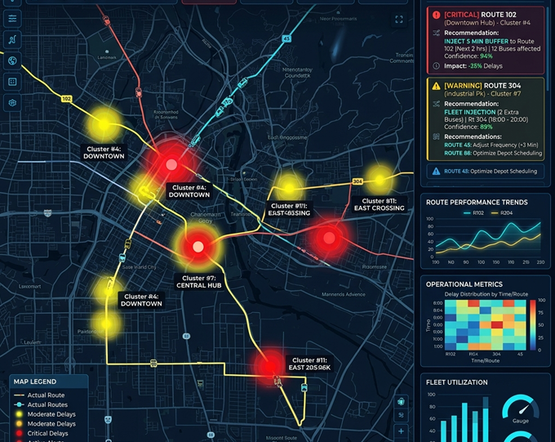
Outcome 3: Geospatial Hotspots & Decision Support
DBSCAN Spatial Hotspot Map: Applies density-based spatial clustering on coordinates of persistent vehicle delays.
Actionable Dispatch Recommendations: A rule-based decision support system converts delay forecasts into operational actions. Recommendations include suggesting schedule buffer extensions during peak hours.

Slide 12
Thank You

